Slide 1

Analysis of New York City Current Job Postings
HIMADRI TEWARI
IST-652 SUMMER 2019

Slide 2


Abstract
According to the US Bureau of Labor Statistics, current job opening is 7.2 million and the job opening rate is 4.5 percent. The job posting is one of the platforms to communicate to the public about any vacancy that an organization needs to fill up. The posting provides the applicants a good perspective about the job, which includes the job description which contains broad details of what the position is for. The posting also communicates to the public what is needed in the person to fulfill the job. To fulfill the job-seeking position and to find the correct person, many organizations hired employment agencies who help with its staffing needs.
The objective of the project is to analyze the current job posting data of New York City. The data collected need to be processed and organized. Once the data is processed, then it is cleaned by correcting any incomplete, duplicate or error related to the data. After that, the data will be explored to identify the trends, hidden pattern, design charts, and visuals.
https://www.bls.gov/news.release/jolts.nr0.htm

Slide 3

About the data
Data Set – The dataset is collected from the Kaggle which contains job posting available in the City of New York’s official job site.
Data Source – The data is hosted in open data platform – NYC Open Data which contains over 1200 datasets with new data added every day. The dataset is updated weekly.
Links –
https://www.kaggle.com/new-york-city/new-york-city-current-job-postings
https://opendata.cityofnewyork.us/

Slide 4

Attributes
Job ID – Job Opening Identification Number
Agency – Name of the New York City agency
Posting Type – Internal or External
# of Positions – Total number of vacancies to be filled under Job ID posted
Business Title – Office title for the job posting
Civil Service Title – Civil Service title for the job posting
Title Code No – Code number for the corresponding civil service title
Level – Civil service title assignment level
Job Category – Occupational group
Full-Time/Part-Time Indicator – F - Full time, P - Part-time
Salary Range From – Lowest salary on a job posting
Salary Range To – Highest salary on a job posting
Salary Frequency – Hourly, Daily, and Annual
Work Location – Physical address for the agency
Division/ Work Unit – Department/area within the hiring agency

Slide 5
Attributes - Continued
Job Description – Description of the job responsibilities
Minimum Qual Requirements – Minimum qualification required for the job posted
Preferred Skills – Preferred skills desired by the hiring agency
Additional Information – Additional Information
To Apply – Instructions on how to apply
Hours/Shift – Projected working hours, working days and shift information
Work Location 1 – Additional work location details for the job vacancy
Recruitment Contact – Recruitment contact information
Residency Requirement – Residency requirements for a given job vacancy
Posting Date – Date and time that a job vacancy was posted
Post Until – Last date that a job vacancy will be posted
Posting Updated – Last date and time a job vacancy posting was modified
Process Date – Date and time that the dataset created date to include the corresponding job vacancy posting.

Slide 6

Descriptive Statistics
Data Comparison
Comparison of Posting Type, Full Time/Part Time, Salary Frequency
Top Agencies
Which are the Agencies have the highest number of jobs posting
Top Job Titles
Which are the top Civil Service Titles, Business Ttitle & Job Categories
Salary Frequency Comparison
Which are the Business Titles got highest and lowest salary frequencies
Yearly & Monthly Job Trends
Yearly and Monthly job posting and # of positions opening trends
Word Frequency
Which are the frequently used words in Job Description, Preferred Skills & Minimum Qualification Required

Slide 7

Exploratory Data Analysis (EDA)

Slide 8
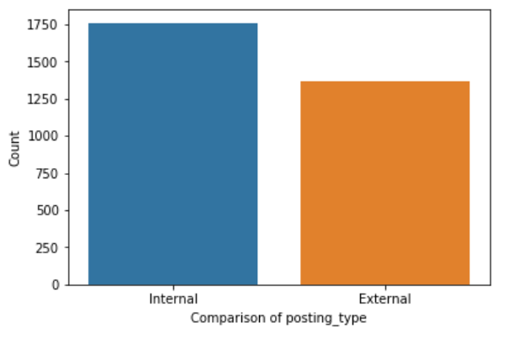
Data Comparison – Posting Type
Internal posting is more than external posting

Slide 9
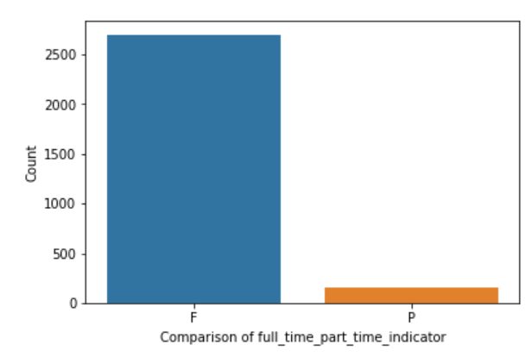
Data Comparison – Full Time vs. Part Time
Full time job posting is more than part time job posting

Slide 10
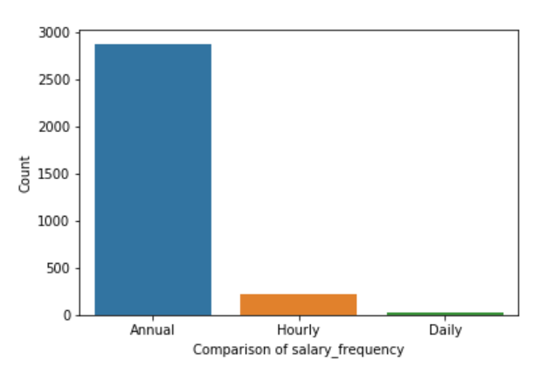
Data Comparison – Salary Frequency
Job posting for annual salary frequency is more than Hourly and Daily

Slide 11
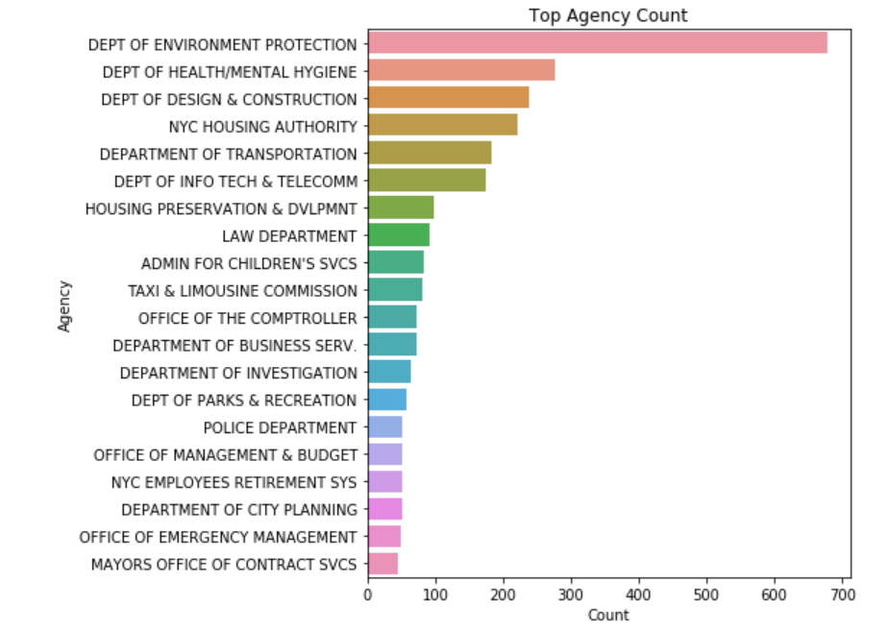
Top Agency Count
Department of Environment Protection is the top agency followed by the Department of Health/Mental Hygiene and Department of Design and Construction

Slide 12
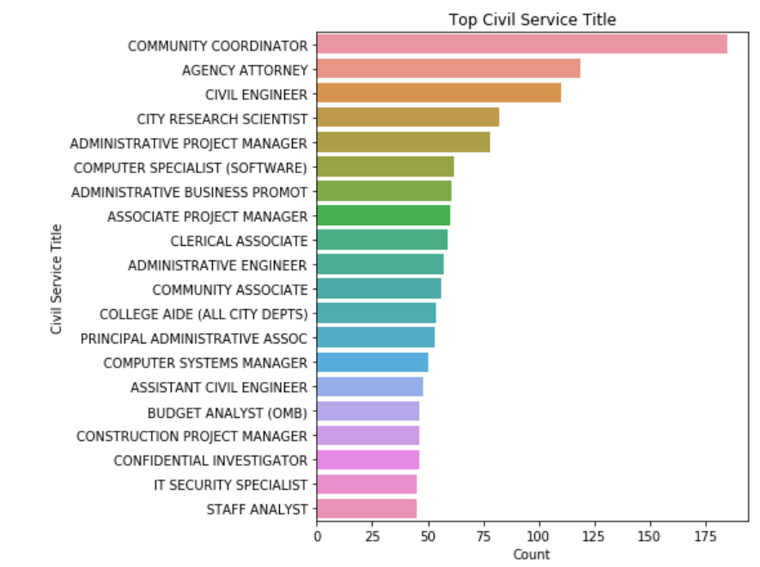
Top Civil Service Title
Community Coordinator got the highest count followed by Agency Attorney and Civil Engineer

Slide 13
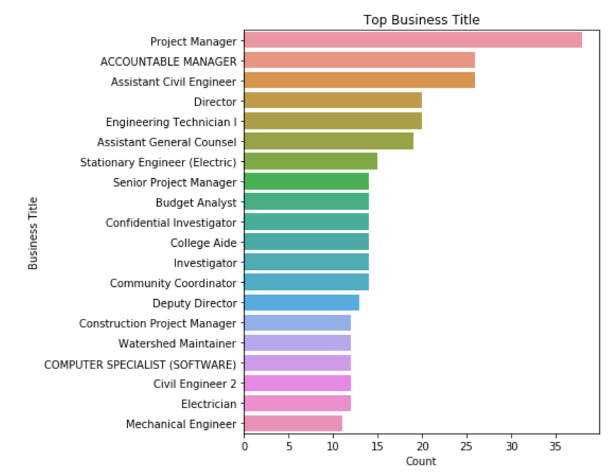
Top Business Ttitle
Project Manager got the highest count. Assistant Civil Engineer and Accountable Manager got the same count. Then followed by Engineering Technician 1 and Director.

Slide 14
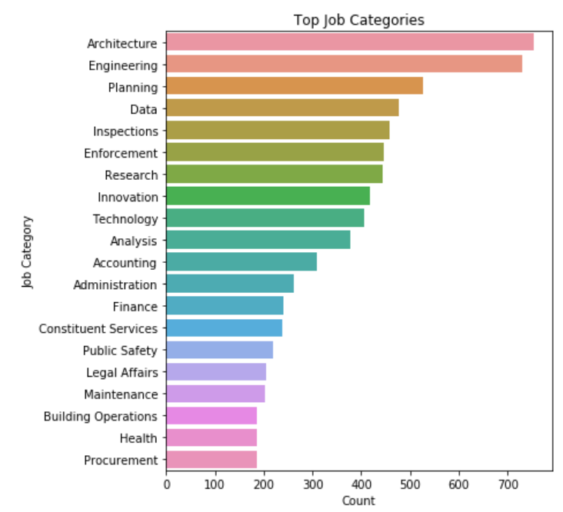
Top Job Categories
Architecture has the highest job posting followed by Engineering, Planning and then Data

Slide 15
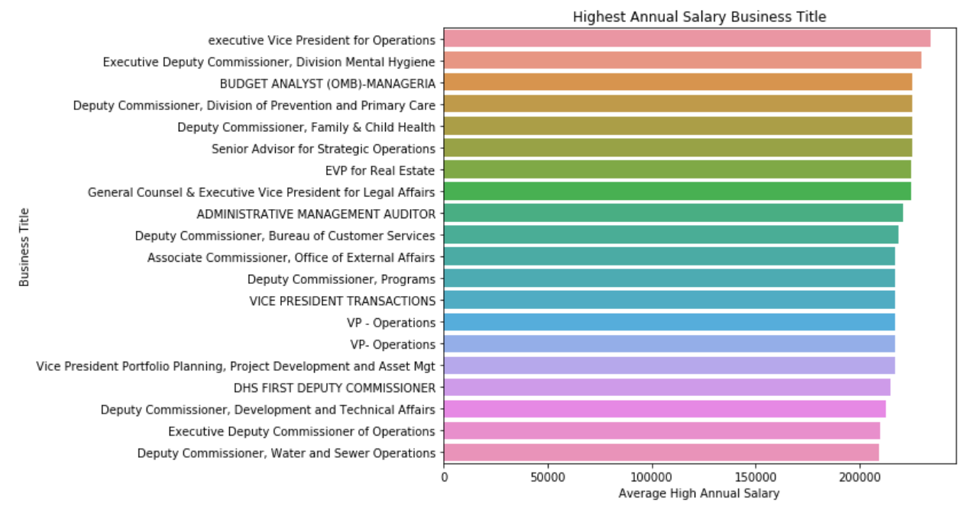
Highest Annual Salary Business Title
Notes:
Executive VP for Operation followed by Executive Deputy Commissioner

Slide 16
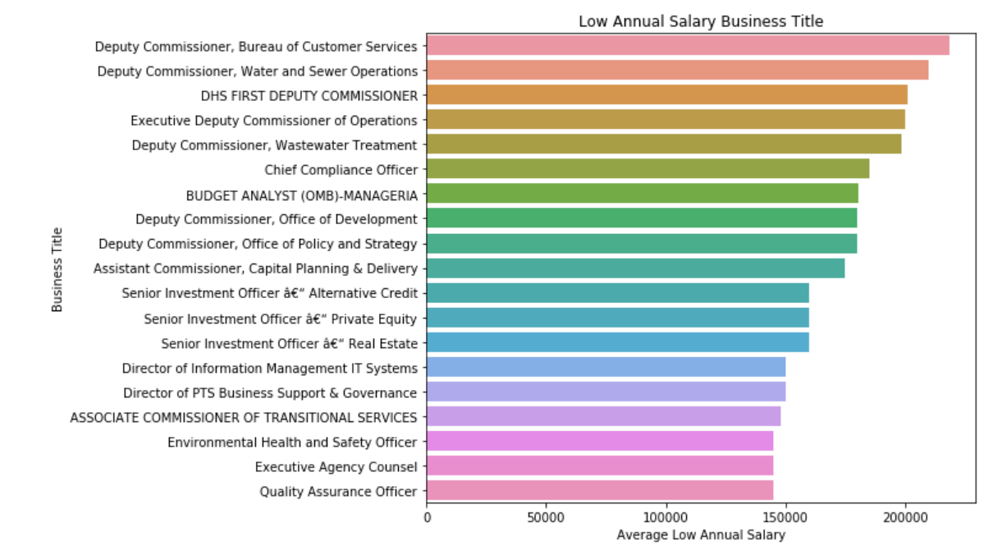
Low Annual Salary Business Title
Notes:
Deputy Commissioner - Bureau of Customer Services followed by Deputy Commissioner – Water and Sewer Operations

Slide 17
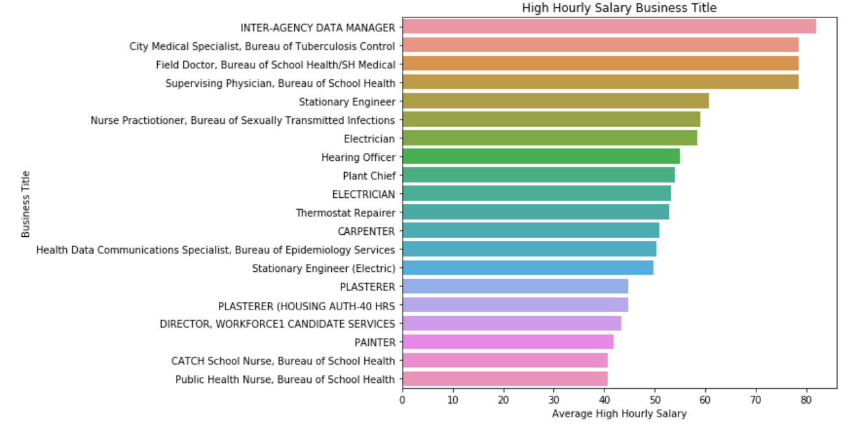
High Hourly Salary Business Title
Notes:
Inter-Agency Data Manager followed by City Medical Specialist – Bureau of Tuberculosis Control

Slide 18
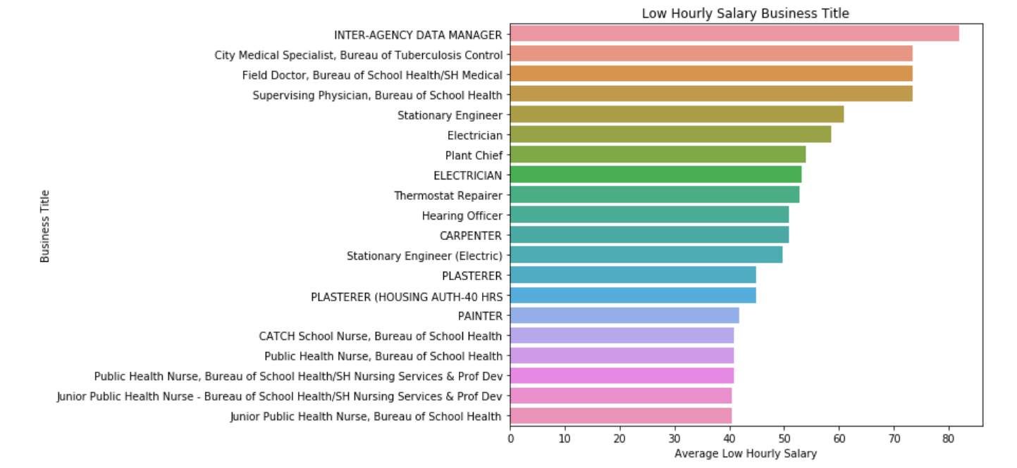
Low Hourly Salary Business Title

Slide 19
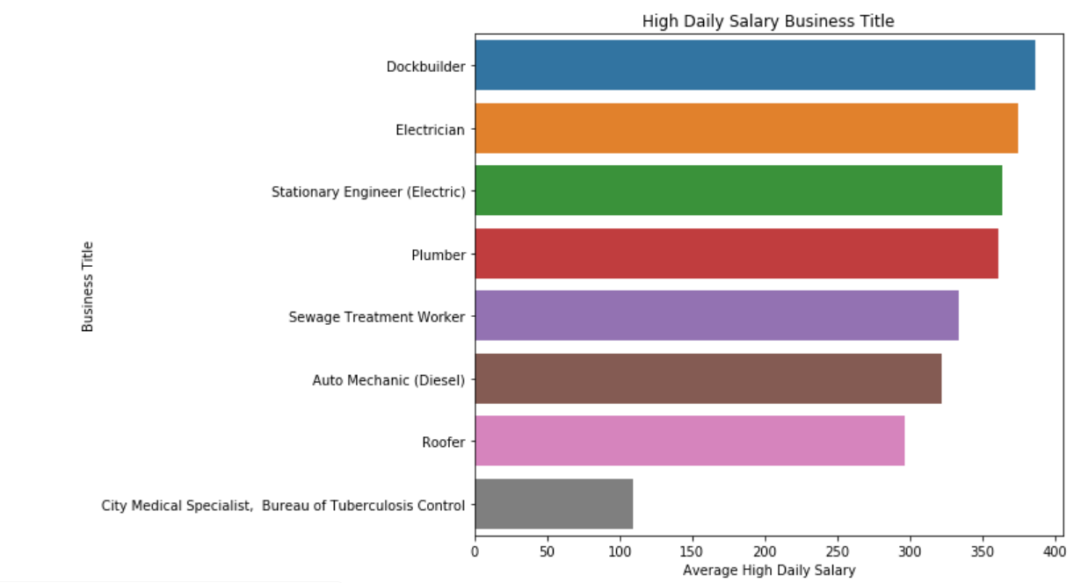
High Daily Salary Business Title

Slide 20
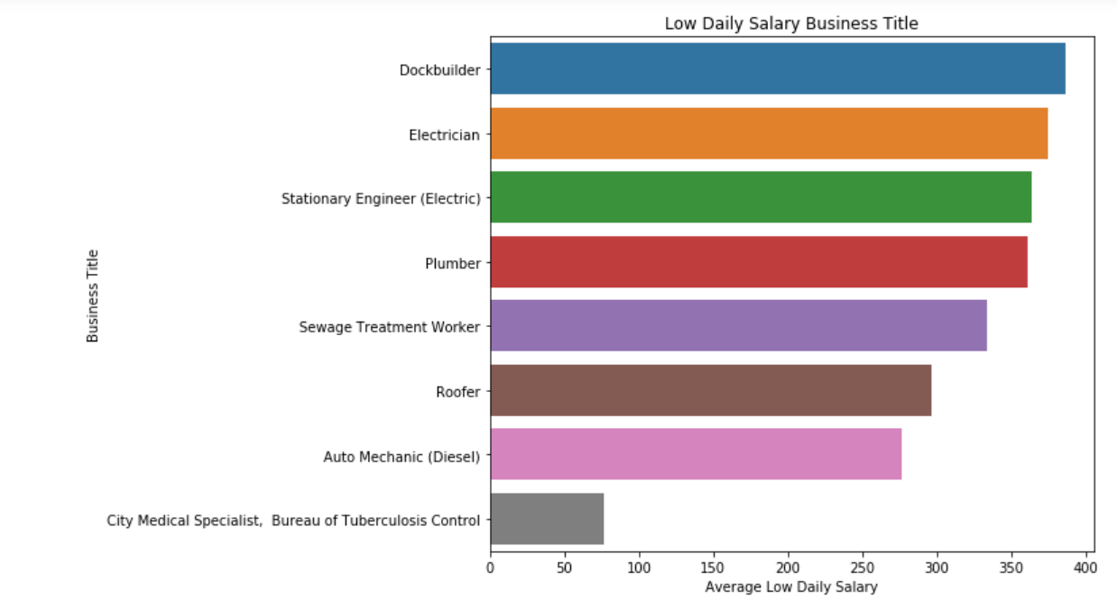
Low Daily Salary Business Title

Slide 21
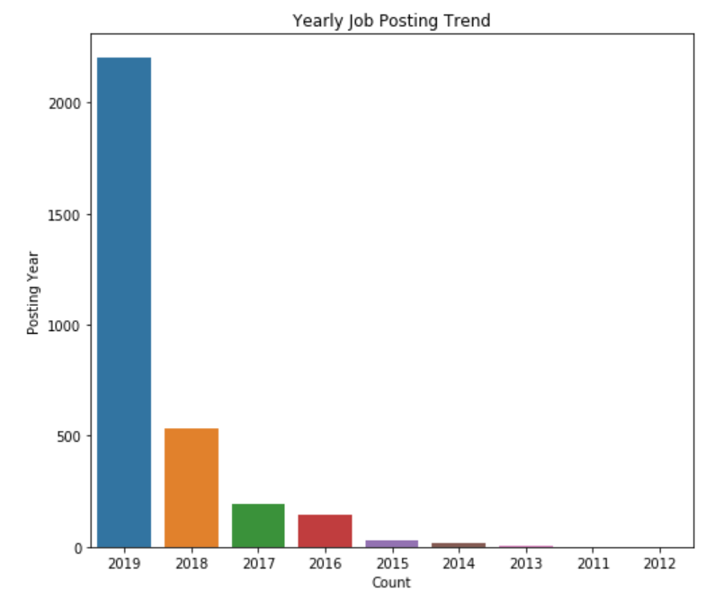
Yearly Job Posting Trend
2019 has the highest job posting followed by 2018 and 2017

Slide 22
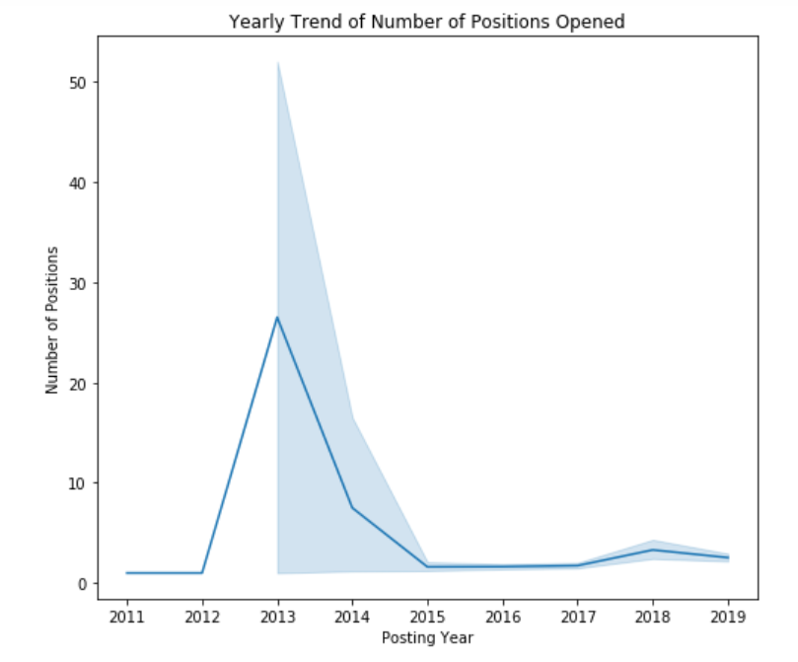
Yearly Trend of # of Positions Opened
2013 has the most number of positions opened

Slide 23
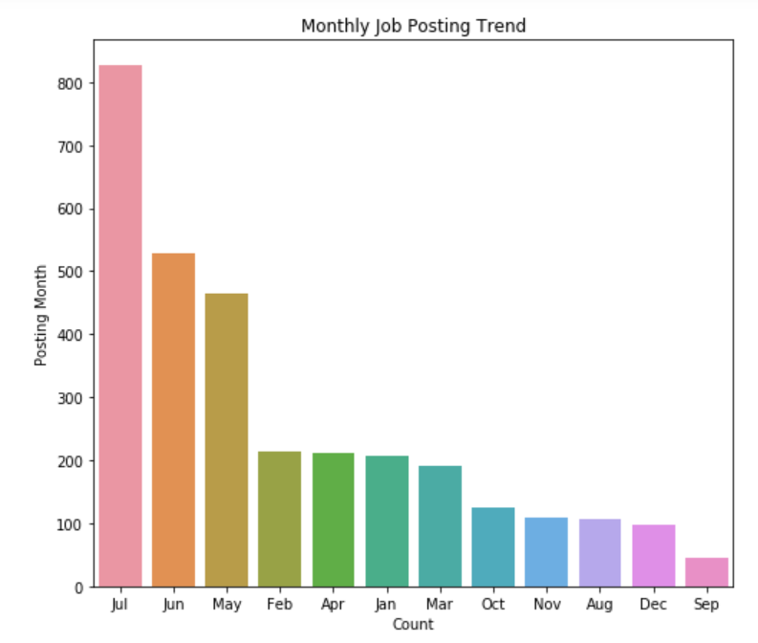
Monthly Job Posting Trend
Month of July has the most job posting followed by June and May

Slide 24
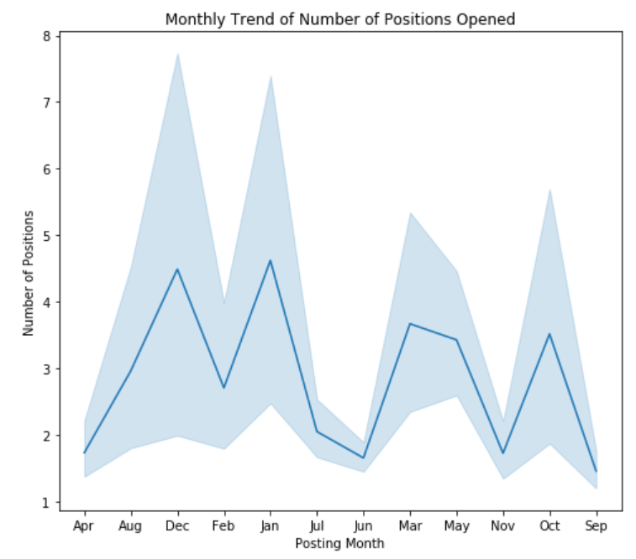
Monthly Trend of # of Positions Opened
December and January got the highest number of positions opened

Slide 25

Word Cloud

Slide 26
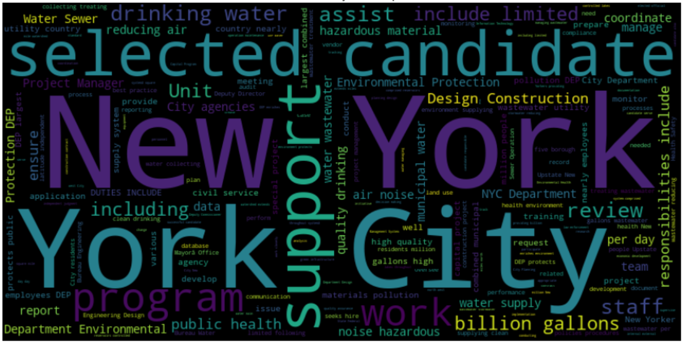
Word Cloud – Job Description

Slide 27
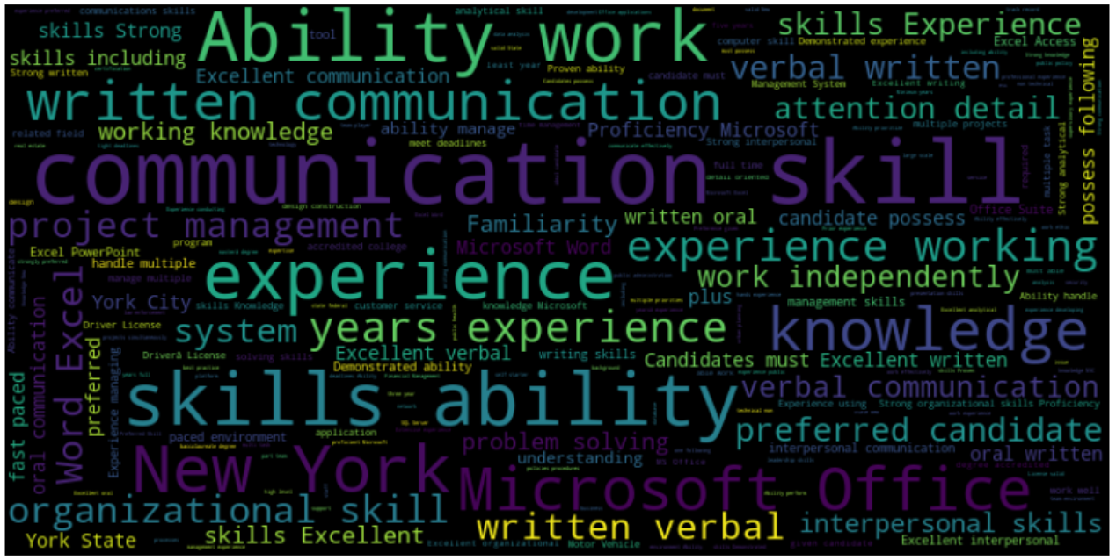
Word Cloud – Preferred Skills

Slide 28

Word Cloud – Minimum Qualification

Slide 29
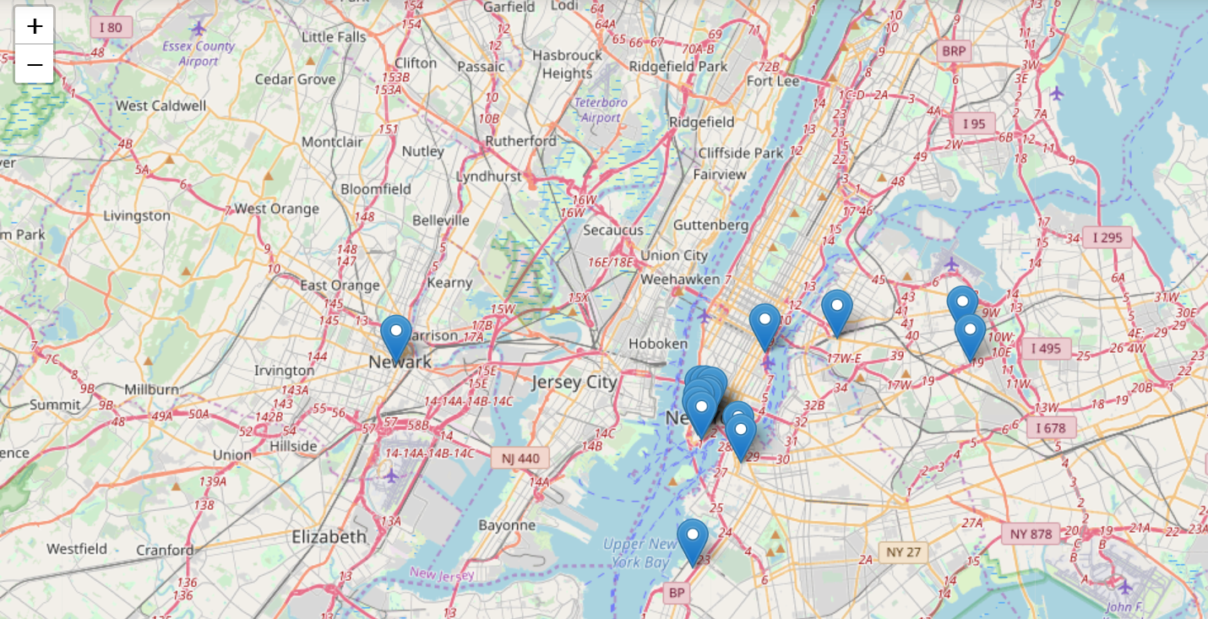
Work Address

Slide 30




Conclusion
Internal job posting is more than external
Organization looks for full time employees in comparison to part time employees
Architecture and Engineering are two most preferred jobs
Most of the companies looks for some years of work experience and college degree
Job posting is more in 2019, but number of positions opened mostly in 2013 which shows positions was not filled up for long
Job posting is more in the month of July, but number of positions opened in the month of December and January

Slide 31


Thank you for your attention
Q&A

